Slide 1
Collaborate! Project Review
Case Study of Workshop for the Long Term Care Revolution (TSB)
"Late life care is often regarded as an economic liability but it can actually be an engine for economic growth. This is an expanding market and we need to radically rethink our approach to long-term care provision, providing options that will enable people to live with more dignity and autonomy". Chief Executive Iain Gray, Technology Strategy Board

Slide 2
The Challenge
A group of strangers met for a week to share ideas and innovate solutions to create a Long Term Care Revolution.
At the end of the week project teams formed to bid for funding for their projects
The funded projects needed to reconnect again after the competitive process to explore potential collaboration.

Slide 3
THE EVENT

Slide 4
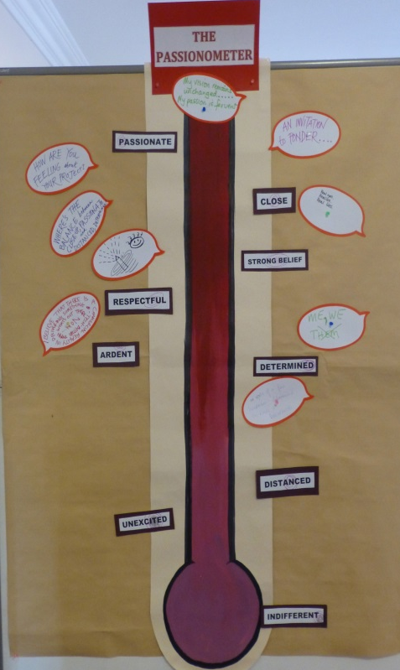
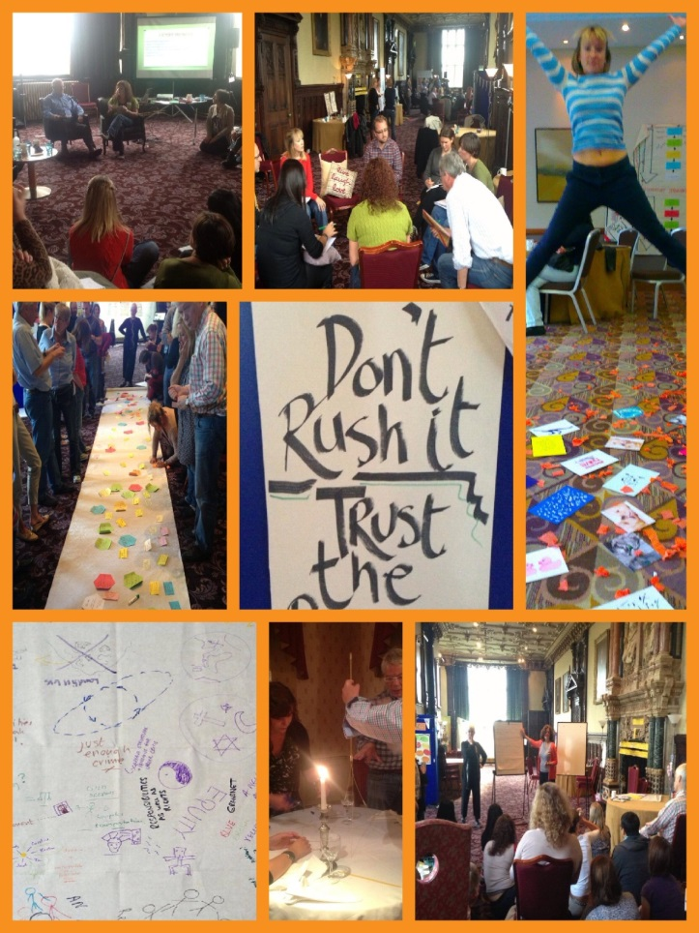
STEP ONE: Reconnect
Reigniting the Passion
Photo Montage of the 5 day event
Review of what has happened since the event

Slide 5
STEP TWO: Share
Sharing Process
Project members shared about their projects and plans
Supportive listening and questioning to develop ideas

Slide 6
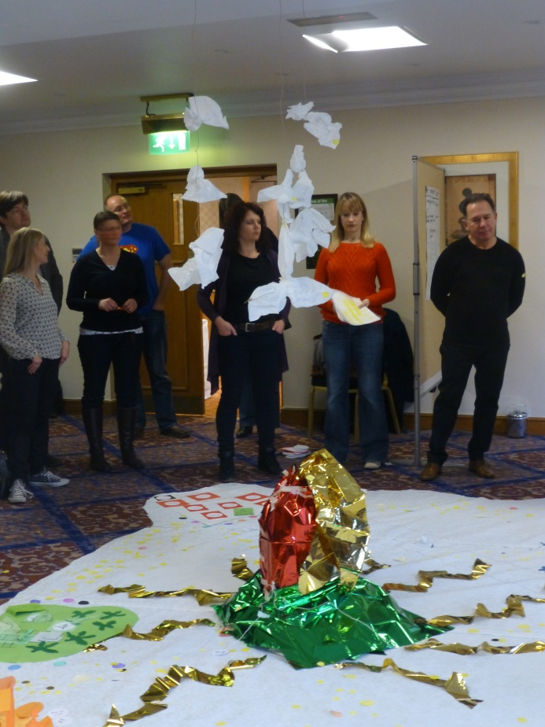
STEP THREE: Explore Potential
How
Creating a project map to show the individual projects and identify possible links
Creative networking space

Slide 7
STEP FOUR: Collaborative Plans
Purpose
Build connections
How
Project teams identified who, what, why and when items for their collaborative action plans
Discussions between teams about areas of collaboration

Slide 8
The Results: 6 Projects Defined
RITA, will create a digital advocate in the form of a humanised avatar, providing a friendly interface between the individual, family, friends, professionals and services, and which could revolutionise how an individual's personal, social, emotional and intellectual needs are captured, interpreted and supported.
POPPINS will explore the potential for a virtual currency that will help retailers establish new relationships with a key sector of their customer-base and build up new uses for the high street.
FLOURISH focuses on reframing the concept of need, and aims to design an intuitive, self-service tool with the potential to improve wellbeing, provide more autonomy and control to the individual.
ONE PRECIOUS LIFE will be applying the principles of high performance athlete training, service and support to people with long term health conditions.
SALTC (Simulating Ageing and Long Term Conditions) flips the long term care problem on its head by using a multimedia simulation to explore acceptance thresholds for specific long term conditions
CASA will create and test commercially viable models of technology-enabled independent living, to make the home a dynamic and responsive environment.

Slide 9
The Results: 6 Projects Teams Ready to Collaborate
After the workshop the project teams went away with a clearer idea of what the other teams were aiming to achieve. The networking and exchange of ideas helped to remind them all of the different strengths in the teams and encouraged the idea that these strengths could be shared across the teams.
There was no longer the competitive reason to keep their development secret so there was an increased willingness to share ideas and to work together to support each project.
It is hoped that several of the project teams will join together on collaborative bids for the next level of funding to take these initial ideas into fully formed solutions so that the long term care provision can be radically changed for our future.

Slide 10
Comments
"The event took us back to Ground Zero; to where there was blood, guts, pain and then glory. It took us back to where we crystallised as a group of people with one vision, one passion and one goal - to disrupt the existing institutional approaches to long term care and forge new ways of living with high level care requirements, fit for the 21st century; ones that will liberate people to live vibrant, dignified lifestyles enhancing their capabilities and purpose in life. It enabled us to consolidate and share our journeys since the life changing sandpit experience and to remind us of our vision in the face of a challenging reality."
Jackie Marshall Balloch, Innovate UK

Slide 11
More Information about the Long Term Care Revolution
https://www.innovateuk.org/-/a-revolution-in-long-term-care

